Slide 1
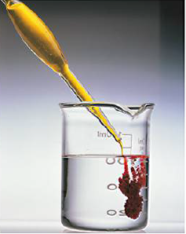
C(s) + O₂ (g) → CO₂ (g)
A C atom reacts with an O molecule, both disappear yielding a CO₂ molecule
Sometimes the reaction advances up to the limiting reactant is consumed: coal burns and disappears, in excess of air, yielding CO₂
In general, a mixture of reactants yield a mixture of reactants and products:
NaCl (aq.) + AgNO₃ (aq.) → AgCl (s) + NaNO₃ (aq.)
Cl⁻ (aq.) + Ag⁺ (aq.) ⇄ AgCl (s)
In the solution we still may find Cl⁻ (aq.) and Ag⁺ (aq.) so that, independently of the amount of AgCl (s):
[Cl⁻ ] [Ag⁺]=Kps (constant at a given T)
The equilibrium constant Kps changes with T:
→ we can dissolve PbCl₂ in water by just heating

Slide 2



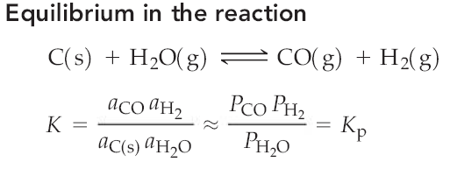


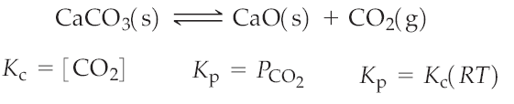
;
;

Slide 3

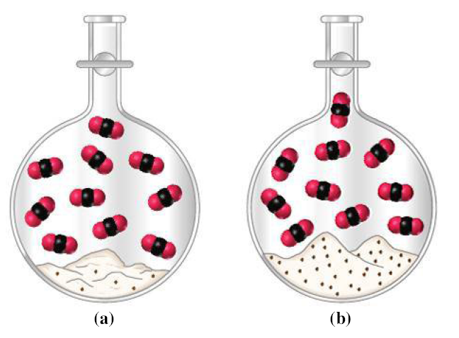
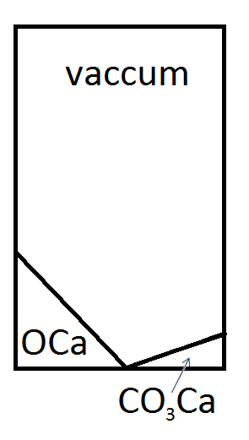
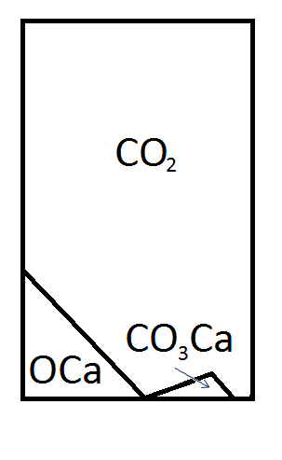
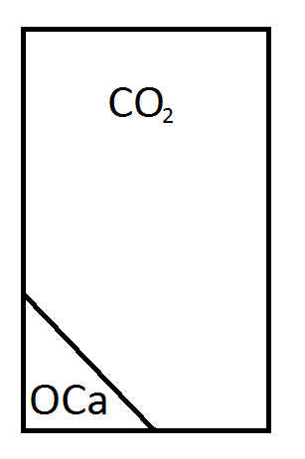

Why activity of solids is constant?
Equilibrium
Introduction of additional CaCO₃ has no effects
Why heterogeneous reactions can be completed?
or

Slide 4




AgCl is poorly soluble in water: K_{sp} = 1.8 × 10⁻¹⁰. Low dissociation in water
AgCl (s) Cl⁻ (aq.) + Ag⁺ (aq.)
Table salt (NaCl) has a high K_{sp} and is quite soluble. High dissociation in water
NaCl (s) Cl⁻ (aq.) + Na⁺ (aq.)
HCl is a strong acid, highly dissociated in in water
HCl + H₂O Cl⁻ (aq.) + H⁺ (aq.)
Acetic acid AcH is a weak acid, poorly dissociated in in water
AcH + H₂O Ac⁻ (aq.) + H⁺ (aq.)

Slide 5
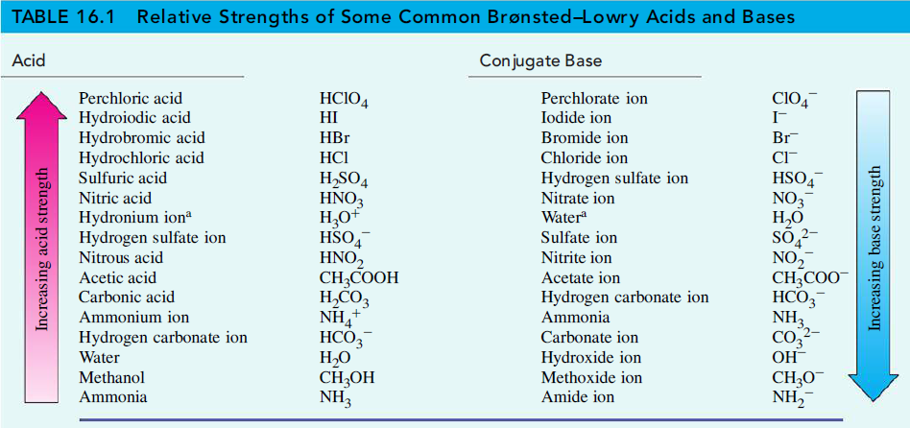
Dissociation is a chemical reaction with water:
HCl + H₂O Cl⁻ (aq.) + H⁺ (aq.)
HCl + H₂O Cl⁻ + H₃O⁺
^{Acid base} ^{base} ^{acid}
Acid: gives a proton
Base: accepts a proton

Slide 7
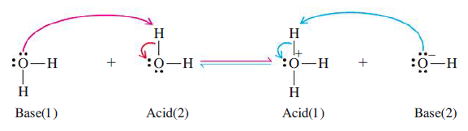

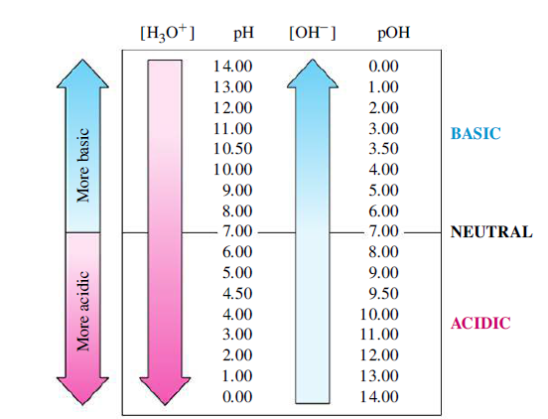




Slide 8
