Slide 1

VQMC
J. Planelles

Slide 2
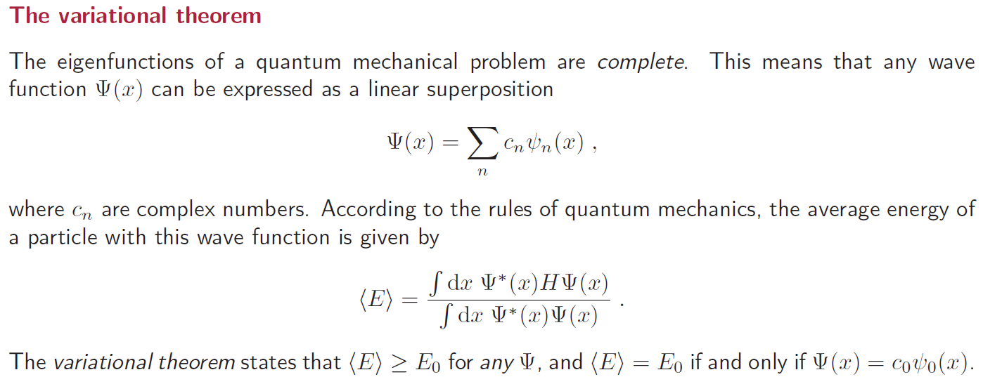
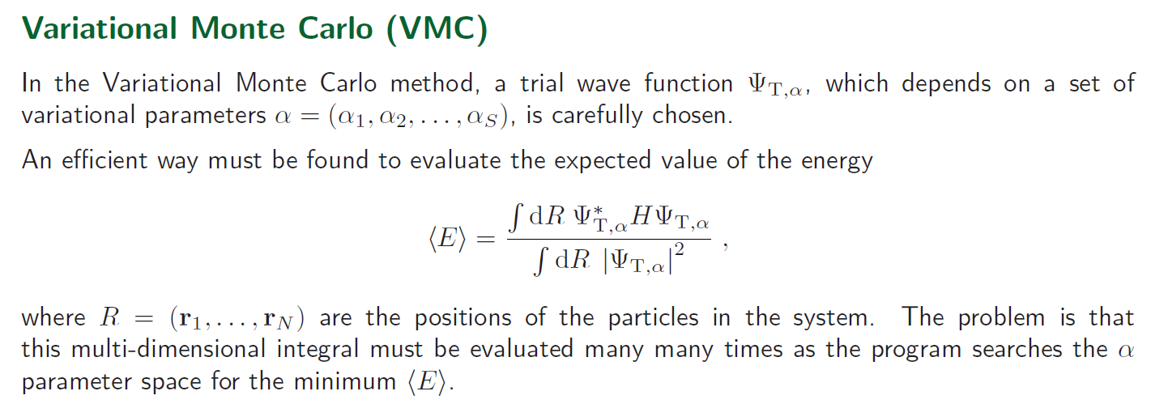

Slide 3
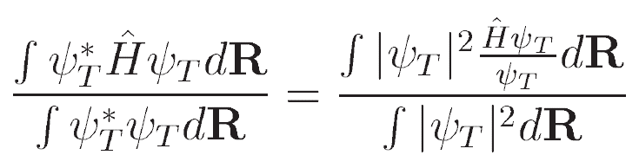
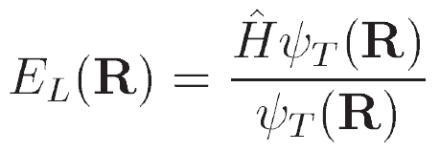
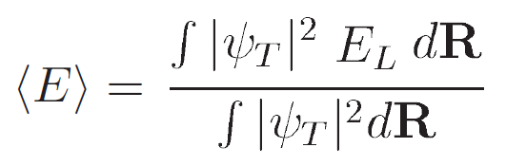
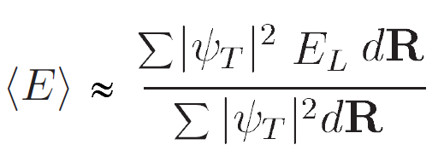
Local Energy

Slide 4
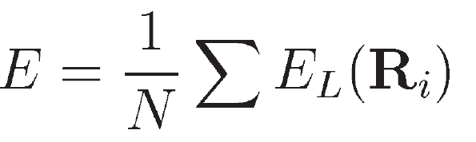
Stochastic Methods
Draw random numbers in the R domain
Average the integrand on the sample
The variance can be calculated as: < E ² > - < E > ².
The method is competitive for multi-dimensional functions
Variatonal Monte Carlo: Importance sampling
By using random numbers uniformly distributed, information is spread all over the domain we are sampling over (areas of very high and low probability are treated on equal foot).
A simple transformation allows Monte Carlo to generate a far better results: drawing numbers from non-uniform density |ψ|²
How to do it? Metropolis algorithm

Slide 5
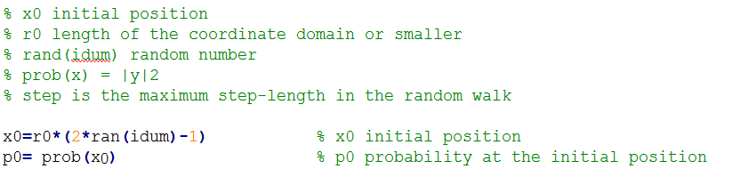
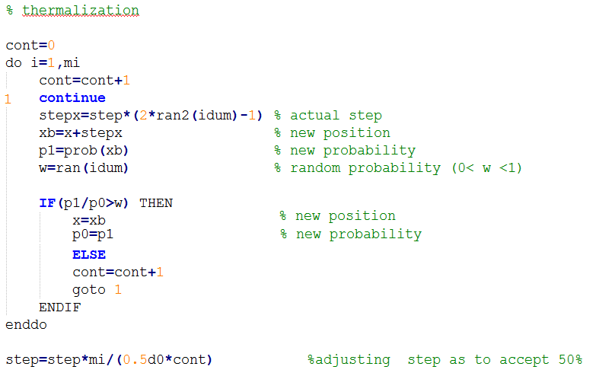
Metropolis

Slide 6
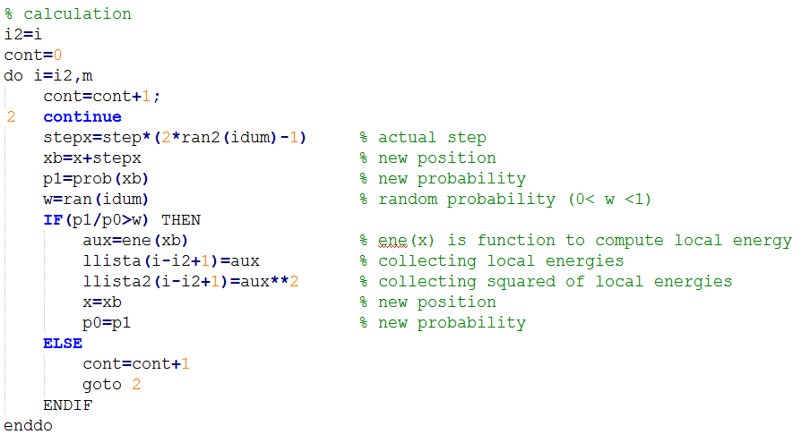
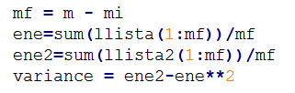
In the main program we calculate the energy and variance:

Slide 7
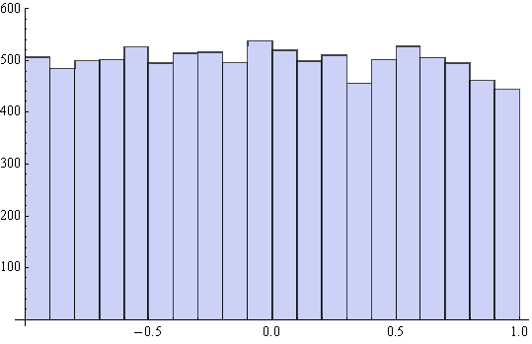
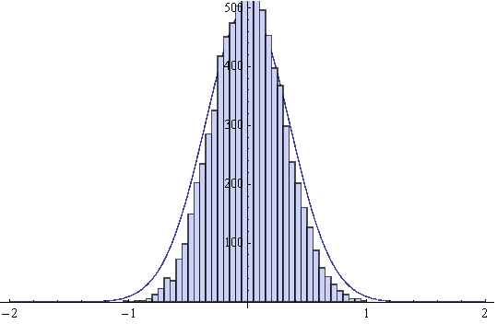
Histogram of 10.000 calculated random numbers uniformly distributed in the domain (-1,1)
Histogram of 10.000 random numbers from non-uniform density |ψ|² in the domain (-1,1) calculated using the Metropolis algorithm
By using Metropolis we can reach the better accuracy using a shorter sample

Slide 8
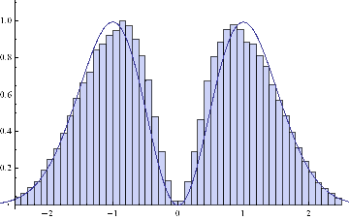
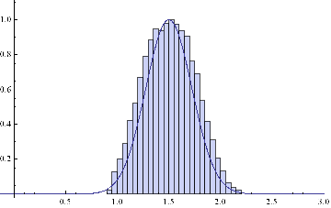
Harmonic Oscillator, first excited state
Histogram of 100.000 random numbers from non-uniform density |ψ|² in the domain (-5,5) calculated using the Metropolis algorithm
Ring-like density defined by
ψ (r,θ) = Exp[-α (r-r₀)²] Exp[-iθ].
Histogram of 50.000 random numbers from non-uniform density |ψ|² in the domain (-0.9,2.2) calculated using the Metropolis algorithm

Slide 9
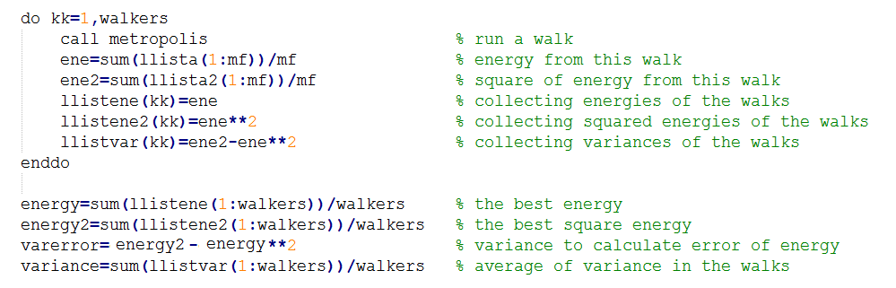
Metropolis random walkers
In complex problems, it is conventional to use a large number of independent random walkers that are started at random points in the configuration space.
(In a multi-dimensional space: a single walker might have trouble locating all of the peaks in the distribution; using a large number of randomly located walkers improves the probability that the distribution will be correctly generated.)
Introducing walkers in the main program

Slide 10

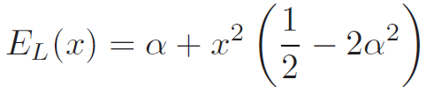
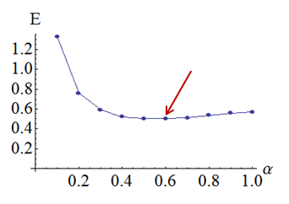
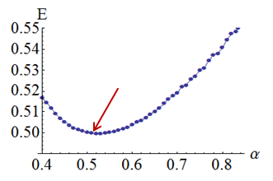

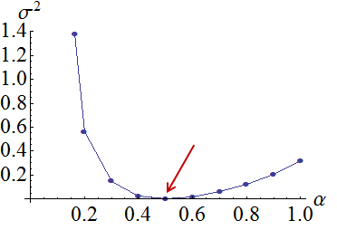
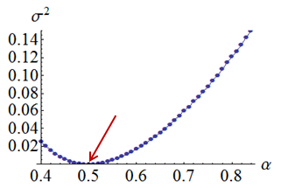
Harmonic Oscillator
Local Energy
Trial function
r₀=1, step 0.5
Probability
points 10.000 walkers 30
points 10.000 walkers 300
Variance is better to
optimize parameters
of the trial function
Using a sample large enough energy and variance points to the same minimum

Slide 11

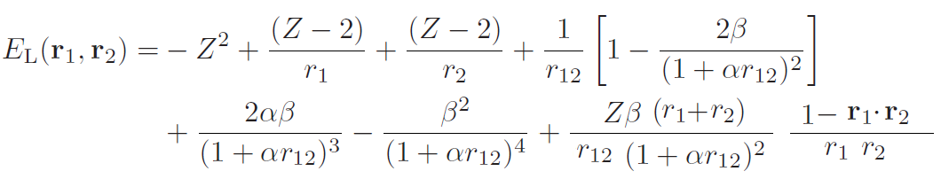

He atom
Trial function
Local Energy
Probability

Slide 12
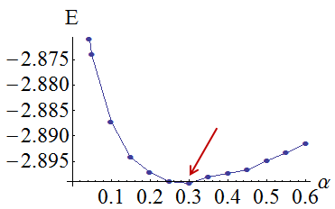
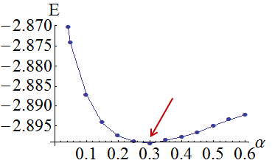
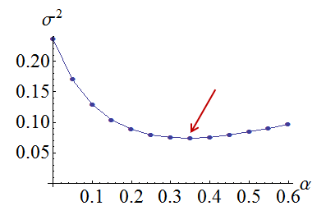
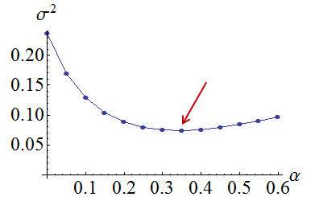
r₀ = 1, step 0.5
Optimizing α for Z=2, β=1/2 (optimum values)
points 100.000 walkers 300
points 300.000 walkers 500

Slide 13
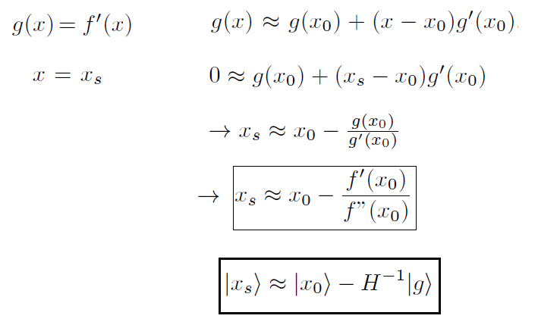
Optimization Trial Wave Function by Newton’s method

Slide 14

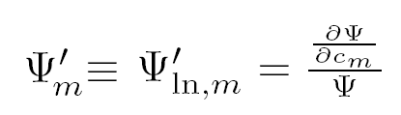
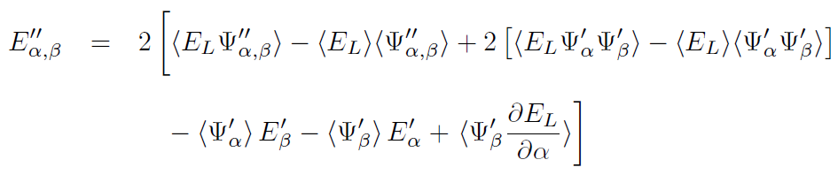


(a) Energy minimization
Xi Lin, Hongkai Zhang, and Andrew M. Rappe, J. Chem. Phys., 112 (2000) 2650.
with

Slide 15
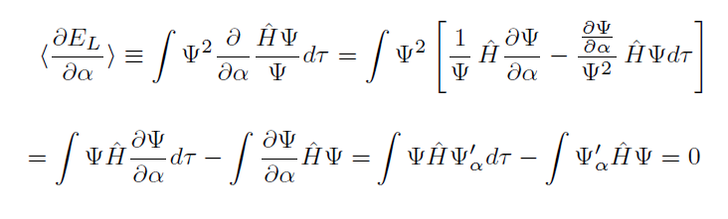
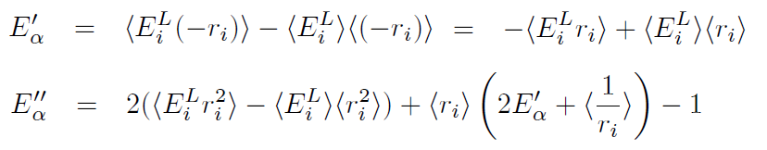

Hydrogen atom:

Slide 16
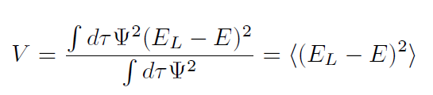
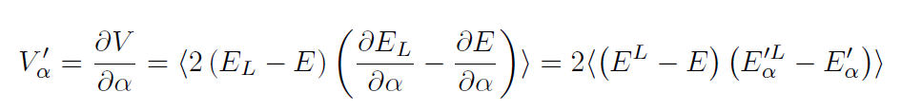

(b) Variance minimization
C. J. Umrigar and C. Filippi, Phys. Rev. Lett, 94 (2005) 150201.
Approximation: disregarding derivative of the wave function:
Additional approximation: disregarding second derivatives :

Slide 17
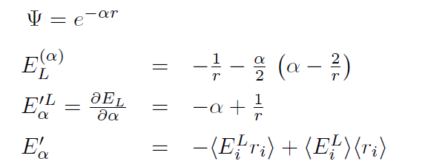
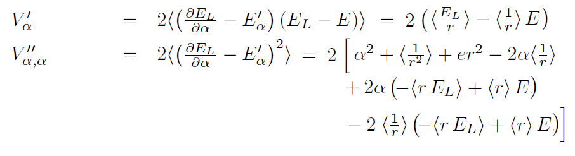
Hydrogen atom:

Slide 18
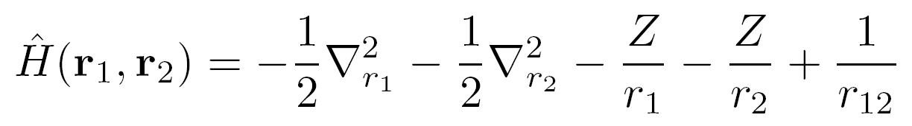
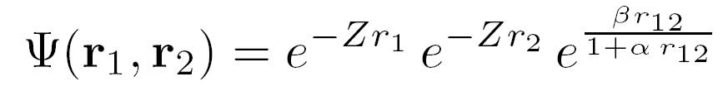
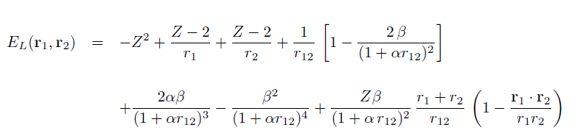

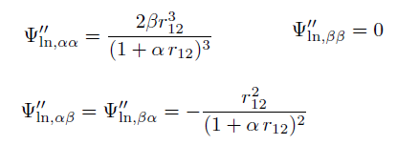

Helium atom (energy minimization):

Slide 19
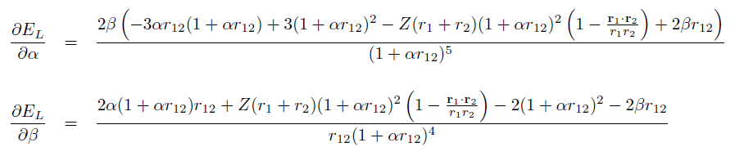
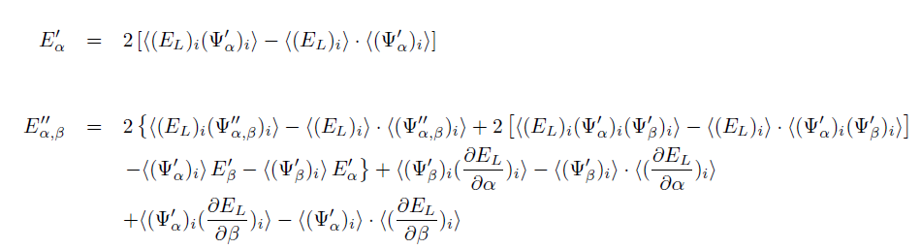
Helium atom (energy minimization) cont:

Slide 20
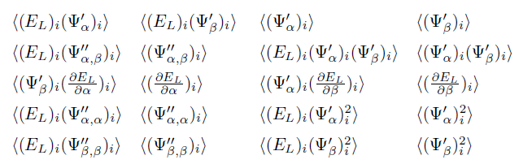

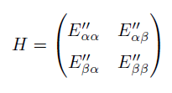



Helium atom (energy minimization) cont:

Slide 21
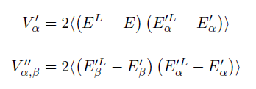

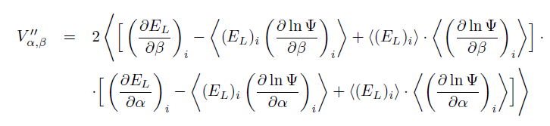
Helium atom (variance minimization) :

Slide 22
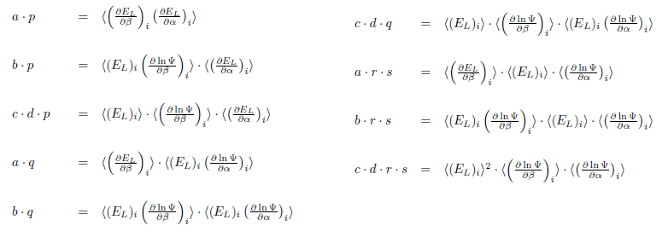
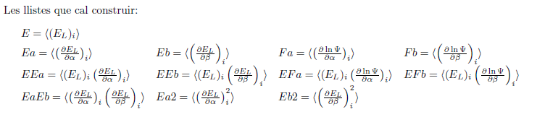




Slide 23
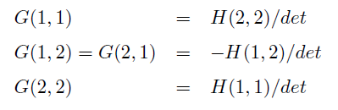


Slide 24
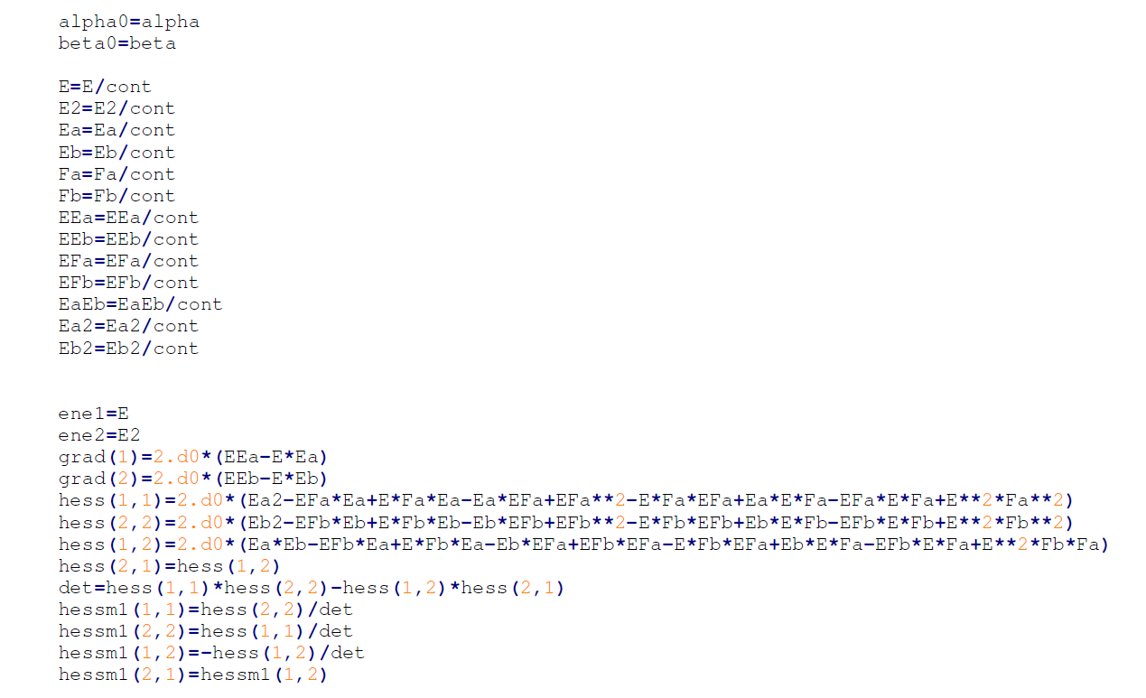

Slide 25
Minimize Energy or Variance?

Slide 26
m, encerts, r0 Z, beta alpha0 alphaf delalpha
500.000, 0.5, 1.d0, 2, 0.5 0.1, 0.8, 0.1
He

Slide 27
m, encerts, r0 Z, beta alpha0 alphaf delalpha
5.000.000, 0.5, 1.d0, 2, 0.5 0.1, 0.8, 0.1
He

Slide 28
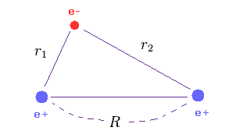

Physics of the Solid State, Vol. 43, No. 4, 2001, pp. 746–751.
(Translated from Fizika Tverdogo Tela, Vol. 43, No. 4, 2001, pp. 714–718.)

Slide 29




Cusp Conditions. The Hydrogen atom case
La cusp conditions supplies VQMC! (in this case)

Slide 30

He
3 variational parameters
Terms:
1rst cusp Conditions: Z=2

Slide 31




Term:
If β=1/2
2ond cusp Condition: β=1/2

Slide 32


Last Term is not singular:
Then, the He wave-function has only a variational parameter:

Slide 33

Optimizing β with VQMC (assuming Z=2 and using a single walker). The obtained value ~ 0.45 is quite close to the expected 1/2

Slide 34



Counter exemple: confined exciton 2D
Limit r →0
Cusp condition: Independent of k=π/L we have:

Slide 35




Numerical calculation (ε = 10 )
Cusp condition:
L=50, k = π/50, m_{e} = m_{h} =1, ε = 10
L=10, k = π/10, m_{e} = m_{h} =1, ε = 10
L=100, k = π/100, m_{e} = m_{h} =1, ε = 10
The cusp condition does not account for confinement.
It gives us the optimum exponent at the limit of no spatial confinement.

Slide 36
Trion:
Actually, how many variational parameters do we have?
In progress …..

Slide 37



What can we model?
….. a hard wall … ~quantum well
Exciton:

Slide 38




Exciton in a platelet disregarding dielectric effects

Slide 39

The simplest model for trions: two-dimension helium-like
Cusp Conditions: Z=2, β = ½ → a single parameter!
A more sophisticated model for trions: two-dimension Serveeg model
Quite some research to carry out….

Slide 40


Trion in a platelet disregarding dielectric effects

Slide 41

Technicalities

Slide 42

Technicalities (cont.)
Example of exciton in a platelet disregarding dielectric effects
100 walkers and 500.000 moves per walker

Slide 43



Technicalities (cont.)

Slide 44





Example HO:

Slide 45
The thing we will not do (I guess)
Diffusion Quantum Monte Carlo (DQMC )

Slide 46






Slide 47





