Slide 1
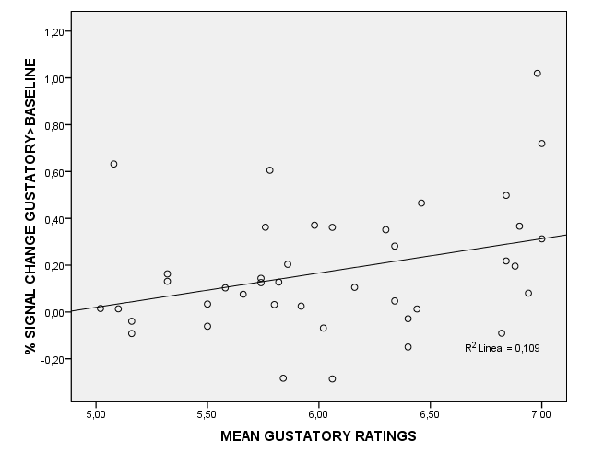
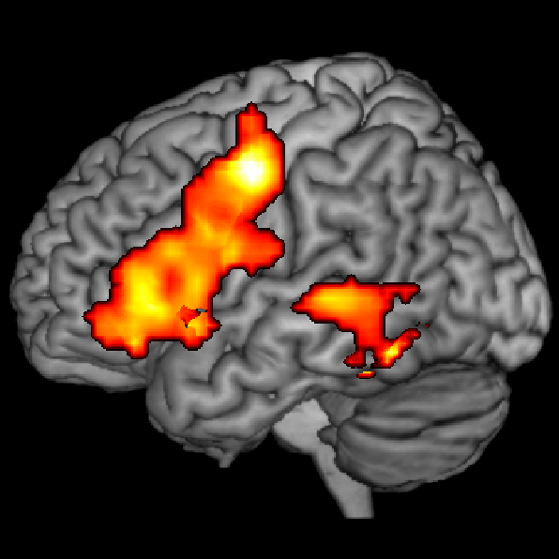
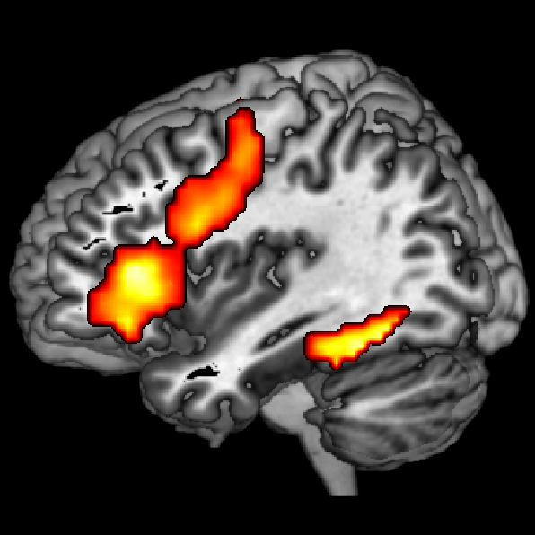
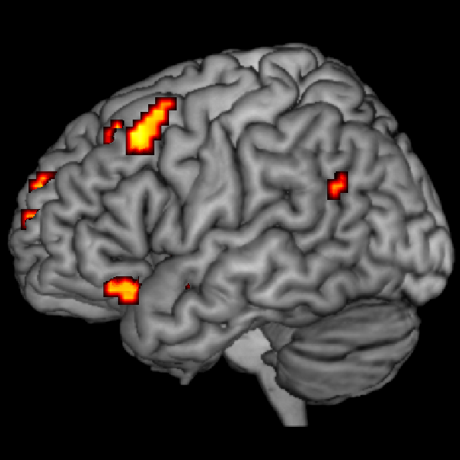
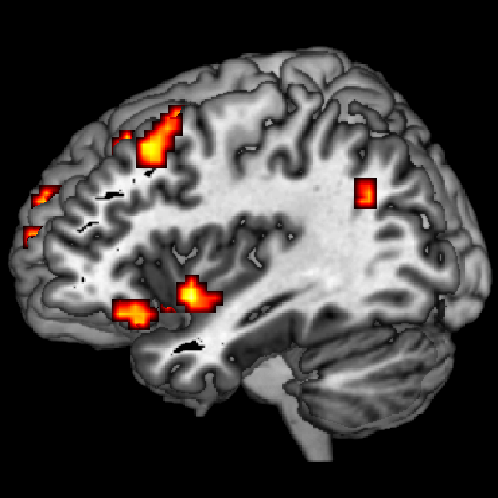
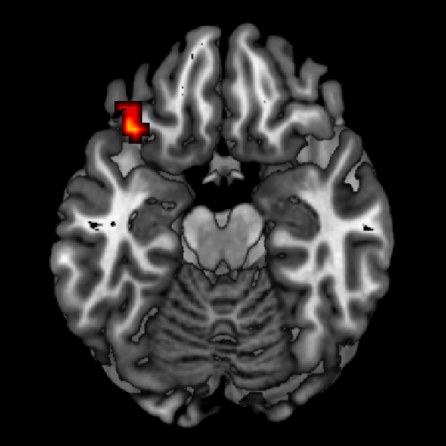
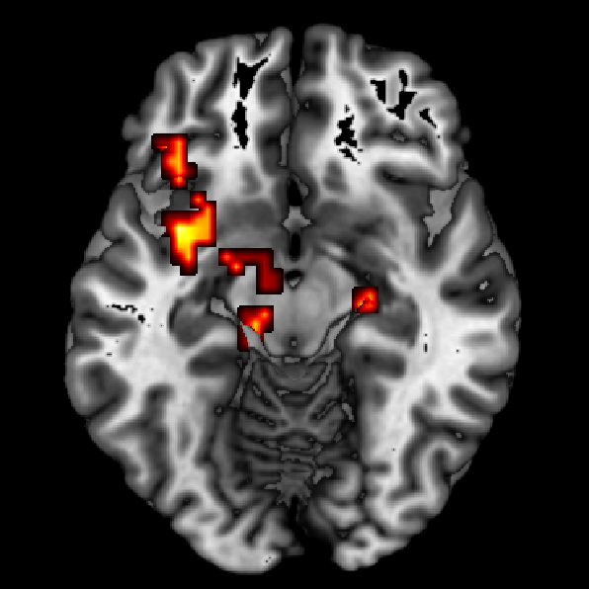
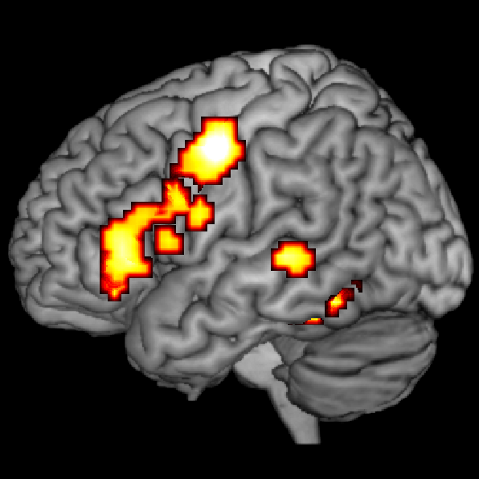
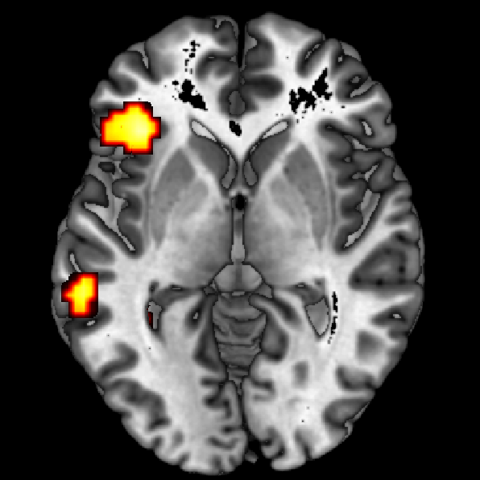
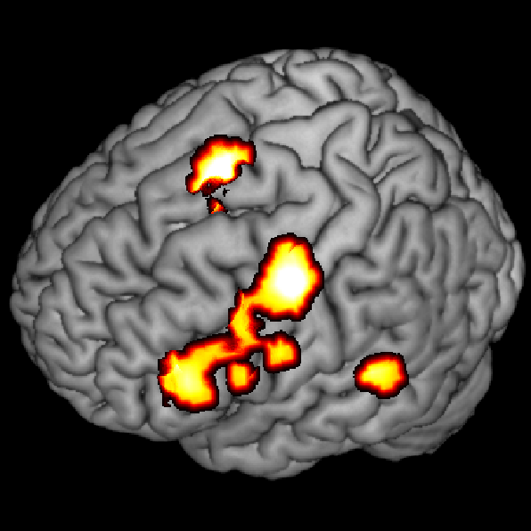
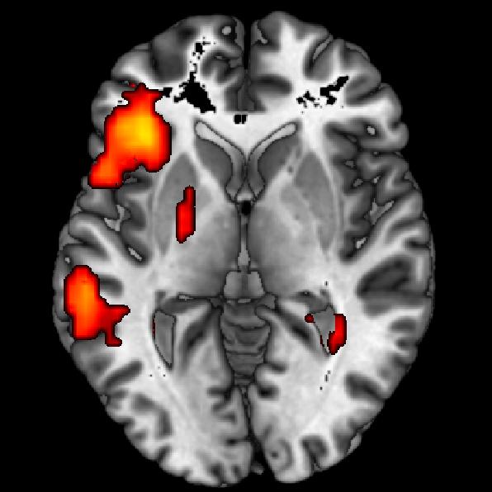
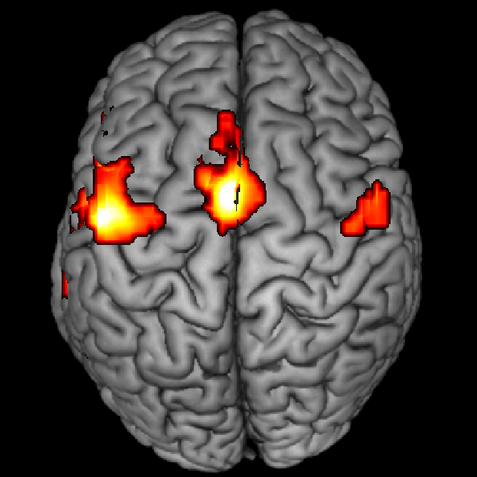
Reading salt activates the gustatory cortex. A. Barrós-Loscertales¹, J. Gonzalez, N. Ventura-Campos¹, J.C. Bustamante, V. Costumero, A.J. Cruz Gómez, C. Ávila¹ Universitat Jaume I, Castelló, Spain barros@psb.uji.es
www.fmri.uji.es
INTRODUCTION:
Words are frequently used together with their referent objects and actions. A theoretical perspective (Pulvermüller, 2001) proposes that words are processed by distributed neural assemblies with cortical topographies that reflect aspects of their references (e.g., feet homunculus activation when reading “kick”) underlying semantic representations.
Previous results tested differential activations of brain areas when action or perceptual words were processed (Martin et al., 1995; Pulvermüller et al., 2005; Gonzalez et al., 2006). Our objective was to test whether words whose meanings have strong gustatory associations would activate primary and secondary gustatory regions such as the insula, the thalamus, the frontal operculum and the orbitofrontal cortex.
METHODS:
Fifty-nine right-handed participants (29 females; mean age=22.51; SD=3.90) carefully read words with and without gustatory connotations in a block-design fashion in single run in the scanner.
These two sets, of 50 words each, were matched by valence, arousal, imaginability, frequency of use, number of letters and syllables, but differed in gustatory associations. Furthermore, a third condition included strings of hash signs which matched the word lengths in the other two conditions. Strings and words were briefly presented for 200 ms. with a SOA of 2000 ms. for 320 s. After the scanner session, participants (n=41, mean age= 23.21; SD=4.23) filled in a questionnaire with a 7-point scale to rate the relevance of the gustatory, olfactory, visual and action association of these words.
FMRI ANALYSIS:
The data were analysed using SPM5. Preprocessing was set by default, but voxels were rescaled to 3 mm³ during the normalisation to the MNI space, and data was spatially smoothed with a 6-mm FWHM Gaussian kernel. The Statistical maps had a threshold at p<0.01 (FDR-corrected) and clusters were considered with a min. k=10 voxels.
FMRI ACQUISITION:
We used a 1.5 T. Siemens Avanto scanner. Gradient-echoT2*-weighted echo-planar MR sequence: TE/TR=50/3000 ms, matrix=64x64, voxel size = 3.94x3.94x6, 5 mm thickness, 1 mm gap, 29 interleaved slices. Anatomical 3D T1-wighted gradient echo pulse sequence: TE/TR= 4.9/11 ms, matrix=256x224x176 voxel size= 1x1x1)
Results
STIMULUS SELECTION:
Prior to our study, 18 subjects were asked to rate a pool of specific nouns in accordance with their gustatory associations– whether the words referred to objects with a strong taste– using a scale ranging from 1 (no or very weak gustatory associations) to 7 (very strong gustatory associations). One list (taste-related words , TW) included words with strong gustatory associations which were presented during the TW-condition; and the other list (control words, CW) included words with no or very weak gustatory associations [mean scores (SD) were 5.70 (.48) vs. 1.25 (.43), respectively, t(98)=48.02, p <.0001] and were assigned to the CW-condition.
Strings of hash signs
Ratings | Tasty words | Control
Gustatory | 6.04 (.60) | 1.42 (.43)
Olfactory | 5.21 (.90) | 1.75 (.72)
Vision | 5.91 (1.25) | 5.68 (1.15)
Action | 3.56 (1.60) | 3.92 (1.07)
####
######
####
Words with gustatory association
Words with no gustatory association
beer
mustard
salt
dart
shutter
blouse
Figure 1. TASTY WORDS > CONTROL WORDS (p<0.01, FDR-corrected): left frontal operculum, lateral orbitofrontal gyrus, insula, thalamus and subthalamic nucleus. The opposite contrast (Control>Tasty) did not show any significant result.
Figure 3. CONJUCTION ANALYSIS: TASTY WORDS & CONTROL WORDS (p<0.05, FWE--corrected): left inferior frontal gyrus (BA44/45), along the left superior temporal gyrus (BA21/22) and supplementary motor area (BA6).
Figure 2. CONTROL WORDS > BASELINE (p<0.01, FDR-corrected): frontal inferior frontal gyrus, the premotor cortex and supplementary motor area, the fusiform cortex and the superior/middle temporal gyrus.
CONCLUSIONS
Reading gustatory-related words activated primary and secondary gustatory cortices compared to reading other specific words with no gustatory associations, thus confirming our hypothesis. In addition, activation in the left lateral orbitofrontal gyrus was seen to be related to subjective ratings on gustatory associations of tasty words. This result is in agreement with the proposed role for this brain region in encoding the oral somatosensation of taste stimuli (see Small et al., 2007 for a review). The results of this study are compatible with a theoretical framework according to which words are processed by distributed cortical systems that involve information about the referential meaning (Pulvermüller, 2005).
REFERENCES:
Gonzalez, J. (2006), 'Reading cinnamon activates olfactory brain regions', NeuroImage, vol. 32, no. 2, pp. 906-912.
Martin, A. (1995), 'Discrete cortical regions associated with knowledge of colour and knowledge of action', Science, vol. 270, no. 5233, pp. 102-105.
Pulvermüller, F. (2001), 'Brain reflections of words and their meaning', Trends in Cognitive Science, vol. 5, no. 12, pp. 517-524.
Pulvermüller, F. (2005), 'Brain mechanisms linking language and action', Nature Reviews Neuroscience, vol. 6, no. 7, pp. 576-582.
Small DM. (2007) The role of the human orbitofrontal cortex in taste and flavour processing. Ann NY Acad Sci, vol. 1121: 136-151.

